Slide 1
Dynamic Data Structures in C
Hyung-Sin Kim
Computing Foundations for Data Science
Graduate School of Data Science, Seoul National University

Slide 2
Practice – Grading System Again (Array version)
#include <stdio.h>
#define STUDENT_NUMS 5
int main(void) {
int midterm[STUDENT_NUMS];
int final[STUDENT_NUMS];
int total[STUDENT_NUMS];
// Input exam scores
for (int i=0; i < STUDENT_NUMS; i++) {
printf(“Input midterm score for student %d: ”, i);
scanf(“%d”, &midterm[i]);
printf(“Input final score for student %d: ”, i);
scanf(“%d”, &final[i]);
}
// Calculate total scores
for (int i=0; i < STUDENT_NUMS; i++) {
total[i] = midterm[i] + final[i];
}
// Output the total scores
for (int i=0; i < STUDENT_NUMS; i++) {
printf(“Total score for Student %d is %d\n”, i, total[i]);
}
return 0;
}

Slide 3
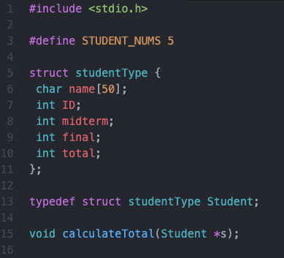
Practice – Grading System Again (Structure version)
Assume that name is a single string (no empty space)
int main(void) {
// Declare an array of structures
/* Your code */
// Receive input from the keyboard for each student
/* Your code */
// Calculate total score (sum) of each student
/* Your code */
// Print each student’s total score
/* Your code */
return 0;
}
// Define calculateTotal
void calculateTotal(Student *s) {
/* Your code */
}

Slide 4
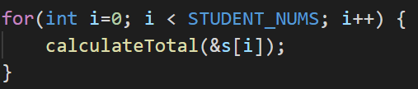

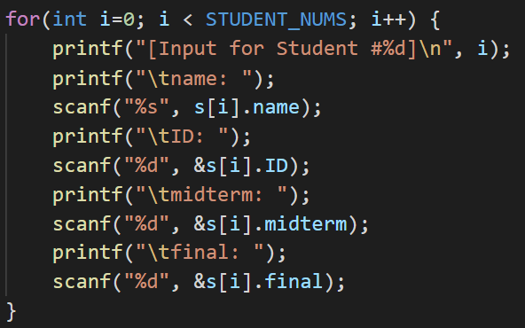
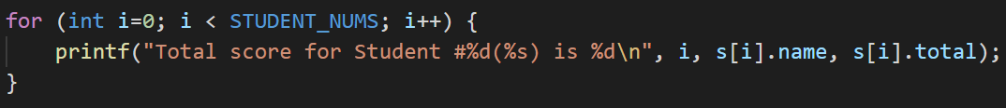
Practice – Grading System Again (Structure version)
int main(void) {
// Declare an array of structures
// Receive input from the keyboard for each student
// Calculate total score (sum) of each student
// Print each student’s total score
return 0;
}
// Define calculateTotal
void calculateTotal(Student *s) {
}

Slide 5
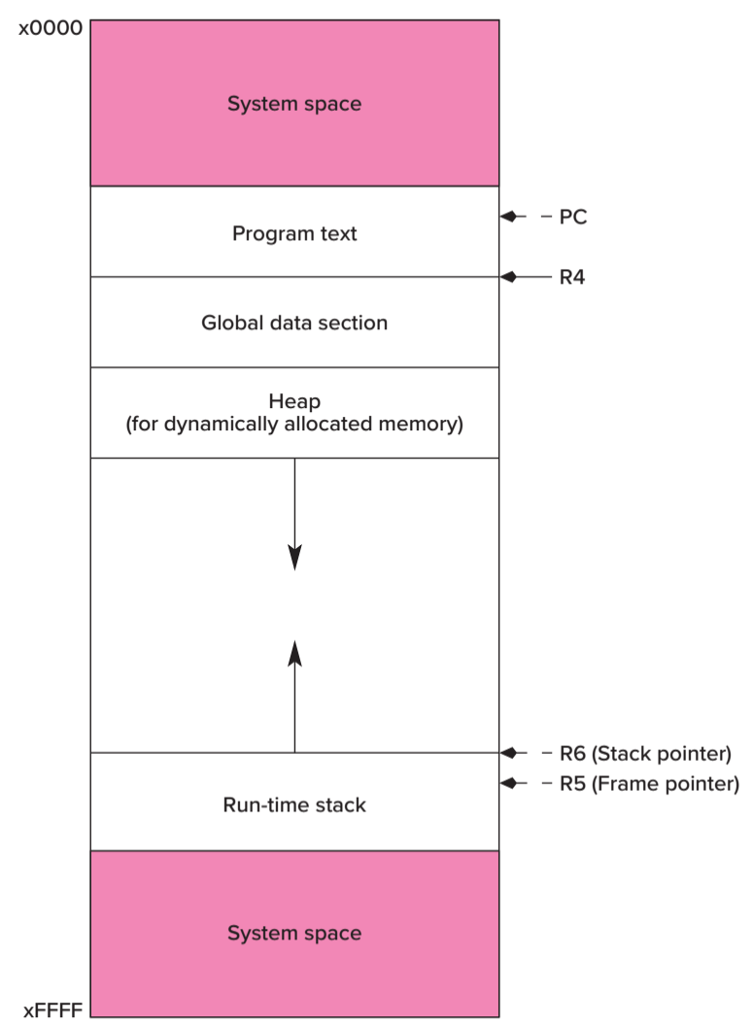
Arrays vs. Linked Lists
Arrays
Pros: Memory is required only for useful values
Cons: Hard to precisely size for our needs (redundancy or shortage)
C uses run-time stack to store arrays
Linked lists
Pros: Easy to dynamically add/remove
Cons: Additional memory is required for linking elements (next/prev pointers)
C uses ?? to store linked lists
Heap
Let’s see how to use this space!

Slide 6
Stack vs. Heap
Stack
Grows upwards
Allocation and deallocation are automatically done by the compiler
Local variable access
Faster and no fragmentation
Heap
Grows downwards
Allocation and deallocation are manually done by the programmer
Global variable access
Slower and fragmented
If you are interested more…
https://www.guru99.com/stack-vs-heap.html

Slide 7
Dynamic Memory Allocation – malloc
Allocation: malloc function
Parameter: Requested memory size (bytes)
Reserve a contiguous memory block of the requested size in the heap space
Return: a pointer to the reserved block or NULL when failing to reserve the block (lack of memory)
It is safe to check if the return is NULL or not
<stdlib.h> needs to be included
Heap grows downwards as more blocks are allocated
Once a block is allocated on the heap, the block survives until we explicitly deallocate it
In contrast to variables in stack that are automatically added and removed

Slide 8
Dynamic Memory Allocation – malloc
Examples
int *intPtr;
intPtr = malloc(sizeof(int));
char *cPtr;
cPtr = malloc(sizeof(char));
Student *sPtr;
sPtr = malloc(STUDENT_NUMS*sizeof(Student));
Hard to expect what return data type users want to get from malloc…
Yes, malloc returns a pointer, but of what data type?
A generic pointer of type void *
You need to type cast the generic pointer for your needs ☺

Slide 9
Dynamic Memory Allocation – malloc
Examples
int *intPtr;
intPtr = (int *) malloc(sizeof(int));
char *cPtr;
cPtr = (char *) malloc(sizeof(char));
Student *sPtr;
sPtr = (Student *) malloc(STUDENT_NUMS*sizeof(Student));
Type cast!
var = (newType) expression;
Yes, malloc returns a pointer, but of what data type?
A generic pointer of type void *
You need to type cast the generic pointer for your needs ☺

Slide 10
Dynamic Memory Allocation – free
Examples
int *intPtr;
intPtr = (int *) malloc(sizeof(int));
free(intPtr);
char *cPtr;
cPtr = (char *) malloc(sizeof(char));
free(cPtr);
Student *sPtr;
sPtr = (Student *) malloc(STUDENT_NUMS*sizeof(Student));
free(sPtr);
Once malloc reserves memory on heap, the memory block survives until you deallocate it
Memory deallocation
free(pointer);
A very common error for beginners: Forgetting deallocation and causing memory overflow in the heap space

Slide 11
Let’s revisit linked lists, but in C!

Slide 12
Single Linked Lists in Python (no sentinel)
class LinkedNode():
def __init__(self, x):
self.val = x
self.next = None
class SLList():
def __init__(self, x: int) -> None:
self.first = None
self.size = 0
def addFirst(self, x: int) -> None:
newFirst = LinkedNode(x)
newFirst.next = self.first
self.first = newFirst
self.size += 1
def getFirst(self) -> int:
if self.first:
return self.first.val
return None
def getSize(self) -> int:
return self.size

Slide 13
Single Linked Lists in C (no sentinel)
typedef struct nodeType LinkedNode;
struct nodeType {
int val;
LinkedNode *next;
};
LinkedNode *createNode(int x) {
LinkedNode *newNode;
newNode = (LinkedNode *) malloc(sizeof(LinkedNode);
newNode->val = x;
newNode->next = NULL;
return newNode;
}
Don’t have the __init__ method in this case.
Actually… there is no method at all
since it is not a class but a structure.
We should define necessary functions outside
Create a new node
with a new memory block on heap

Slide 14
Single Linked Lists in C (no sentinel)
typedef struct listType SLList;
struct listType {
LinkedNode *first;
int size;
};
int main(void) {
SLList myLL = {NULL, 0};
addFirst(&myLL, 10);
printf(“%d\n”, getFirst(&myLL));
getSize(&myLL);
printSLList(&myLL);
}
We need to define these functions

Slide 15
Single Linked Lists in C (no sentinel)
void addFirst(SLList *LL, int x) {
LinkedNode *newFirst;
newFirst = createNode(x);
newFirst->next = LL->first;
LL->first = newFirst;
LL->size++;
}
int getFirst(SLList *LL) {
if (LL->first != NULL)
return LL->first->val;
return 0;
}
int getSize(SLList *LL) {
return LL->size;
}
void printSLList(SLList *LL) {
LinkedNode *curr = LL->first;
printf(“size: %d, firstVal: %d, allVals: ”, getSize(LL), getFirst(LL));
while (curr != NULL) {
printf(“%d->”, curr->val);
curr = curr->next;
}
printf(“END\n”);
}

Slide 16
We can add nodes to a linked list. Great!
Then? You will experience memory error sometimes later
since there is no deallocation!

Slide 17
Practice – Delete a node from SLList
For simplicity, we assume that every node has a unique integer
Step 1) Make SLList work first
It can take some time because you are unfamiliar yet! Discuss with your peers!
Step 2) Make a search function
LinkedNode *searchNode(SLList *LL, int x) { /* Your code */ }
Step 3) Make a delete function that is a bit more complex than SearchNode since you need to reorganize next pointers and decrease list size
void deleteNode(SLList *LL, int x) { /* Your code */ }

Slide 18
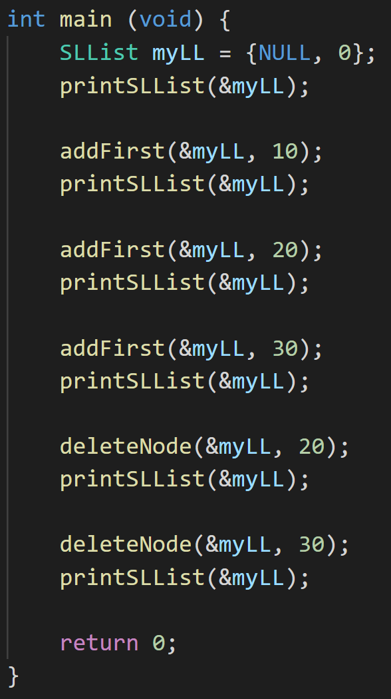
Practice – Delete a node from SLList
What do you see on your screen when you write the main function as that on the rightside?
I mean… if your code ever works… ☺

Slide 19
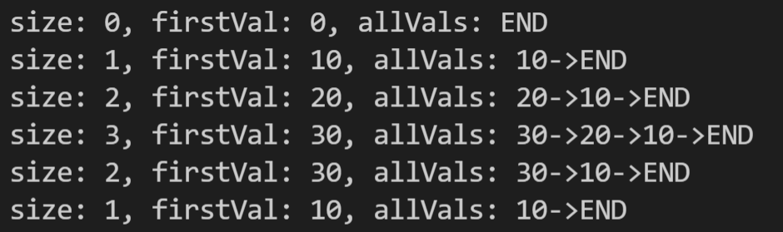
Practice – Delete a node from SLList
What do you see on your screen when you write the main function as that on the right side?
I mean… if your code ever works… ☺

Slide 20
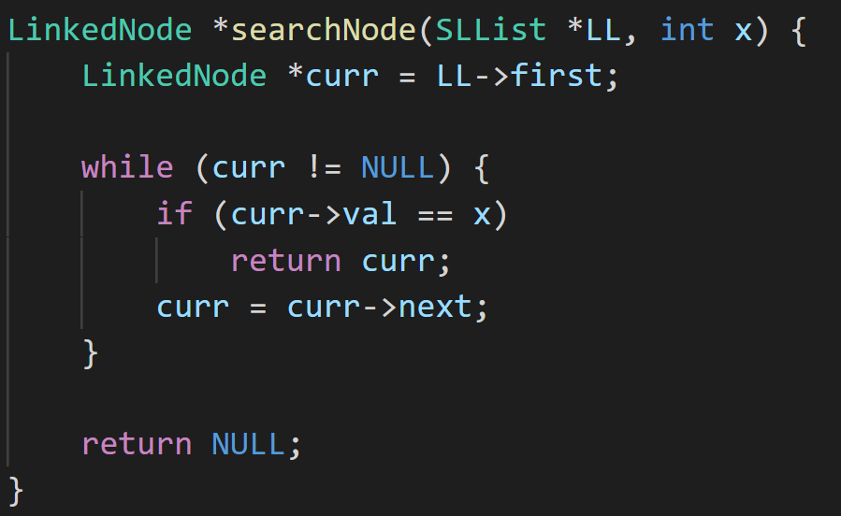
Practice – Delete a node from SLList
searchNode implementation

Slide 21
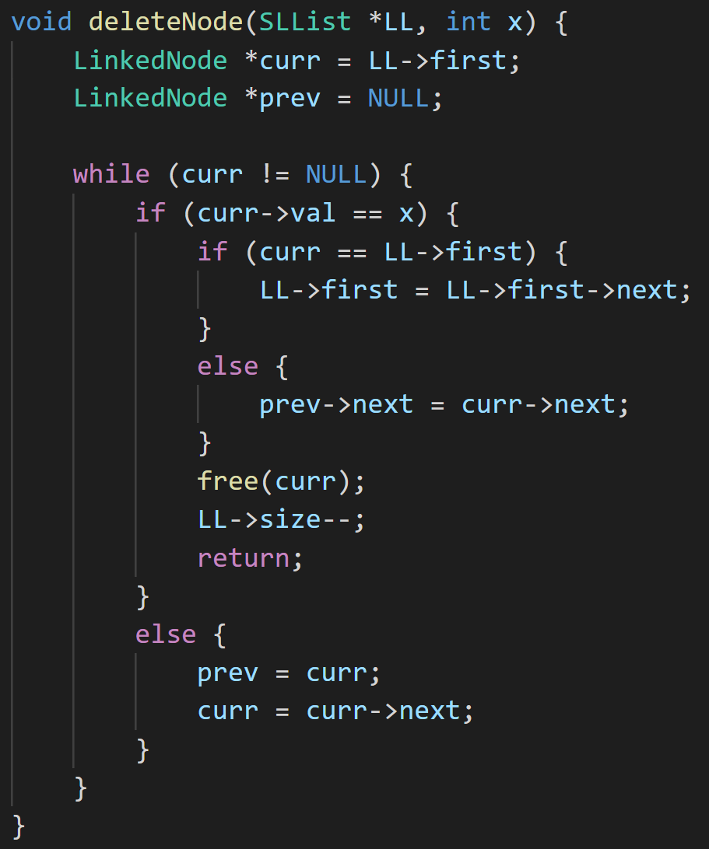
Practice – Delete a node from SLList
deleteNode implementation

Slide 22
Thanks!

